Slide 1
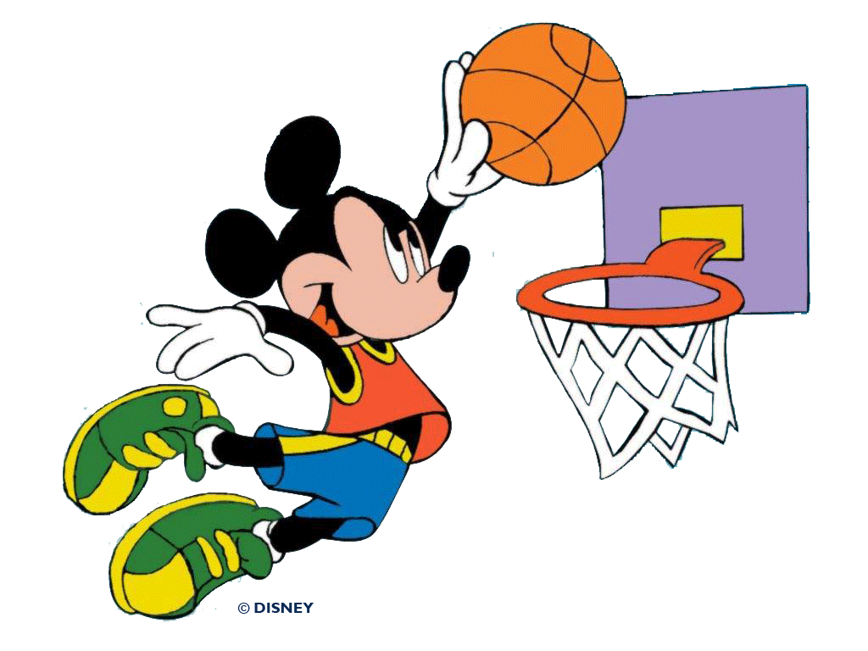
Physics of Sports
Dr. Muhammad Ali Yousuf
mali@jhu.edu
http://pages.jh.edu/~maliyou1/Physics_of_Sports/
Image https://amazingpict.com/hd-wallpapers-background-images/mickey-mouse-basketball/

Slide 2
The physics of sports isn’t rocket science.
It’s much harder.
Bob Adair in The Physics of Baseball

Slide 3
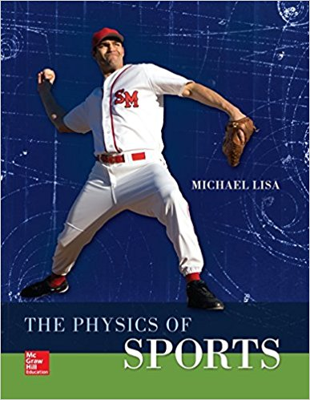
Introduction
Course Number: AS.360.167.13
Dates: Monday 1/8/2018 - Friday 1/26/2018
Times: Monday - 6-8:30 | Friday - 6-8:30
Location: Homewood Campus, Hodson 213
Webpage: http://pages.jh.edu/~maliyou1/
Textbook: Michael Lisa, The Physics of Sports.
ISBN-13: 978-0073513973
Grading: Class participation 30%, two written assignments (15%+15%), project (40%).

Slide 4
Introduce yourself:
Write, in one single line (since there are many participants, if you write on multiple lines, messages will get mixed up):
(1) your preferred name,
(2) your area of study and/or research, and
(3) something interesting about you which will help others remember you.
I’ll start with myself …
(1) My name is Ali, (2) though I am a theoretical physicist by education, my field of research is Biomedical Engineering/Medical Devices. (3) I am a big fan of Star Wars movies and deeply inspired by Yoda, I am.

Slide 5
History of the Physics of Sports
In early 1850s the subject of rotating artillery shells was explored by the German professor Heinrich Magnus. In this project he investigated sideways deflection of artillery shells which were rotating.
In 1877 Lord Rayleigh wrote a paper on the irregular flight of a tennis-ball. It can be found here.
It is also a good topic for projects.

Slide 6
Plan for Today
Introduction to Physics of Sports and a survey of kinematics
Warm-up: Basic Concepts
Quantifying the world of sports
When we don’t have exact numbers
The center of mass
Racing, Mathematically
Phelps in Beijing (Swimming, https://www.youtube.com/watch?v=AVExBUxIcIs&list=PLm4DmlOa3zay-bL9vDVPTShhEzZhjgtDa)
Bolt in Berlin (https://www.youtube.com/watch?v=3nbjhpcZ9_g)
Rope-climbing and diving
Measurement tools available, photo and video analysis.

Slide 7
Measurement tools available, photo and video analysis

Slide 8
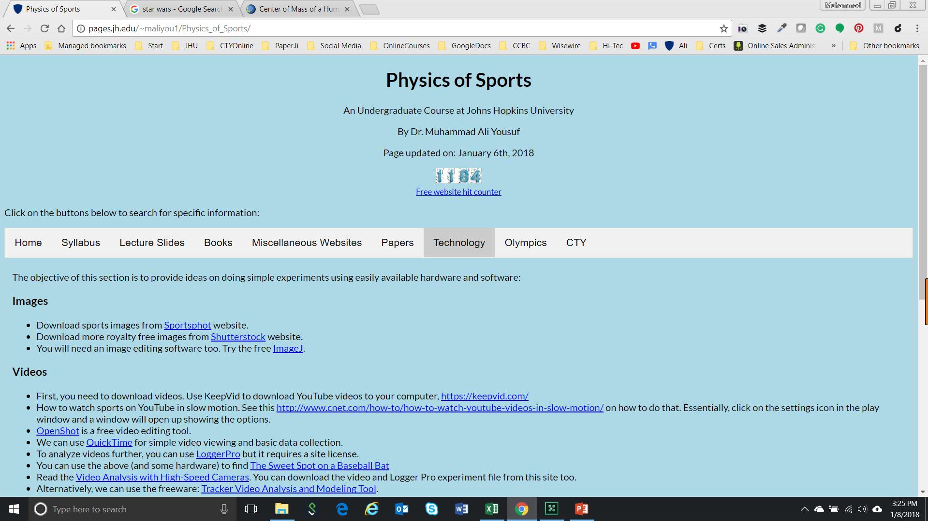
Resources on the Website http://pages.jh.edu/~maliyou1/Physics_of_Sports/

Slide 9
Images
Download sports images from Sportsphot website.
Download more royalty free images from Shutterstock website.
You will need an image editing software too. Try the free ImageJ.

Slide 10

Videos
First, you need to download videos. Use KeepVid to download YouTube videos to your computer, https://keepvid.com/
OpenShot is a free video editing tool.
Freeware: Tracker Video Analysis and Modeling Tool.
Free Android App, Vernier Graphical Analysis. It provides interface to LoggerPro but you can also do experiments with onboard sensors.
Free iPhone App, Vernier Graphical Analysis . It provides interface to LoggerPro but you can also do experiments with onboard sensors.

Slide 11
Sound
You will need the Audacity software to record and analyze the sound spectrum. Audacity is free, open source, cross-platform software for recording and editing sounds. It can be found here: http://audacity.sourceforge.net/
To measure time between two events (like hitting a ball which then strikes a wall) you can use computer’s internal sound card to record and analyze it.
See: Using the Sound Card as a Timer by Aguiar and Pereira, at http://scitation.aip.org/content/aapt/journal/tpt/49/1/10.1119/1.3527753

Slide 12
Simulations
The following PhET and other simulations each has some relevant physics concept explained:
Projectile Motion
Forces and Motion
Energy Skate Park
Sports Software Download

Slide 13
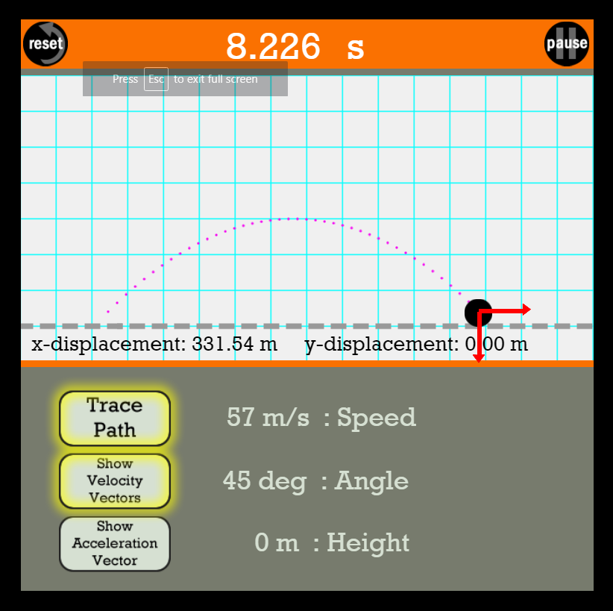
Projectile Motion
http://www.physicsclassroom.com/Physics-Interactives/Vectors-and-Projectiles/Projectile-Simulator/Projectile-Simulator-Interactive

Slide 14
Plan for Today
Introduction to Physics of Sports and a survey of kinematics
Warm-up: Basic Concepts
Quantifying the world of sports
When we don’t have exact numbers
The center of mass
Racing, Mathematically
Phelps in Beijing (Swimming, https://www.youtube.com/watch?v=AVExBUxIcIs&list=PLm4DmlOa3zay-bL9vDVPTShhEzZhjgtDa)
Bolt in Berlin (https://www.youtube.com/watch?v=3nbjhpcZ9_g)
Rope-climbing and diving
Measurement tools available, photo and video analysis.

Slide 15
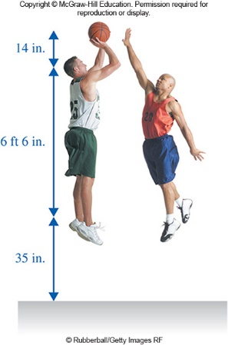
Heights
“Typical” sizes of a basketball player taking a jump shot.

Slide 16
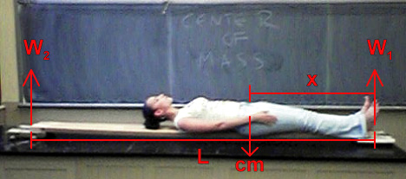
Where is the center of mass of a human?
A person's center of mass is slightly below his/her belly button, which is nearly the geometric center of a person.
Males and females have different centers of mass- females' centers of mass are lower than those of males.
The average ratio of center of mass to height in females is approximately 0.543 and the average ratio of center of mass to height in males is approximately 0.560.
https://hypertextbook.com/facts/2006/centerofmass.shtml

Slide 17
Differences between sports
Does height matter in sports?
https://www.youtube.com/watch?v=IcTNIk0yfj0

Slide 18
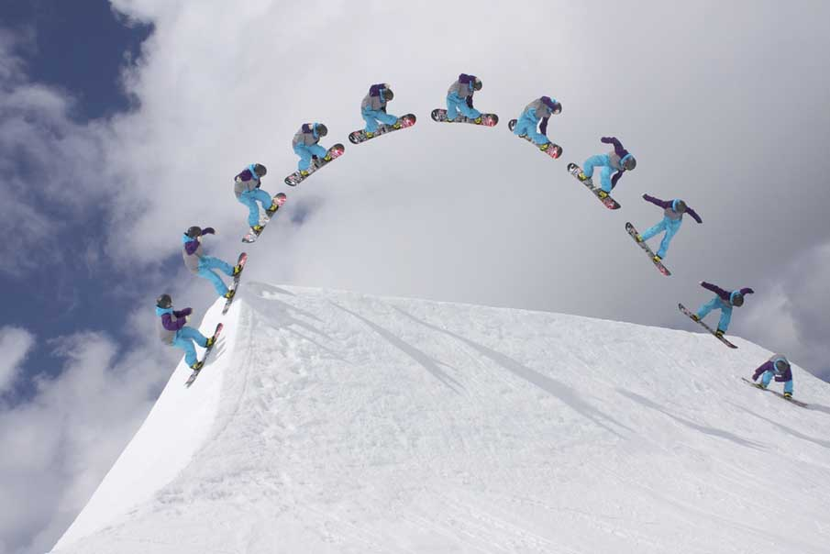
http://www.pxleyes.com/blog/2012/03/50-brilliant-examples-of-sequence-photography/

Slide 19
Questions (Estimates)
What is the height of the sportsman? (that fixes a scale for the photo)
Assuming the first image at the origin of the coordinates, what is the maximum height reached?
What is the range?
What is the launch angle?
What are the horizontal and vertical accelerations?
What is the initial launch velocity v? (you need kinematic equations here).
What is the time of flight? (you need kinematic equations here).
What is the frame rate (fps) used by the camera?

Slide 20
y
x
x | v0x | ax | t | vfx
y | v0y | ay | t | vfy

Slide 21
The physics of ski jumping, https://pdfs.semanticscholar.org/e956/0e12923567efef9e37bead23b9e85bfe0ca3.pdf

Slide 22
Plan for Today
Introduction to Physics of Sports and a survey of kinematics
Warm-up: Basic Concepts
Quantifying the world of sports
When we don’t have exact numbers
The center of mass
Racing, Mathematically
Phelps in Beijing (Swimming, https://www.youtube.com/watch?v=AVExBUxIcIs&list=PLm4DmlOa3zay-bL9vDVPTShhEzZhjgtDa)
Bolt in Berlin (https://www.youtube.com/watch?v=3nbjhpcZ9_g)
Rope-climbing and diving
Measurement tools available, photo and video analysis.

Slide 23
Swimming

Slide 24
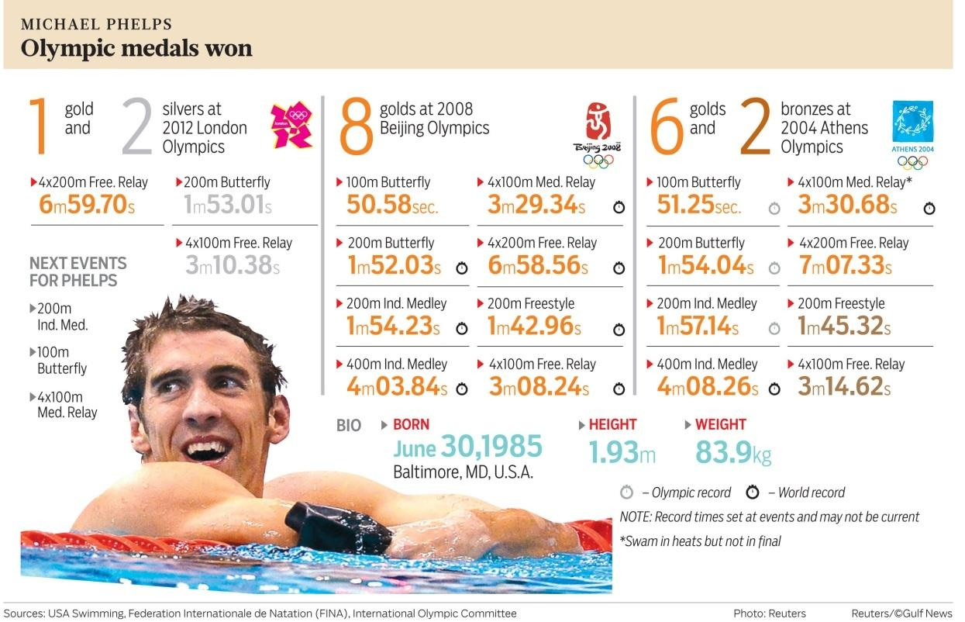
Phelps in Beijing (section 2.1)
http://cdn23.us1.fansshare.com/photos/michaelphelps/diet-1021618498.jpg

Slide 25
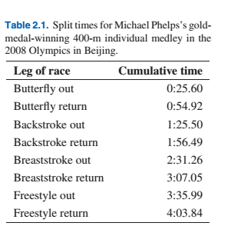

Slide 26
Calculations
Let’s find Phelps’s speed during the second length in m/s:

Slide 27
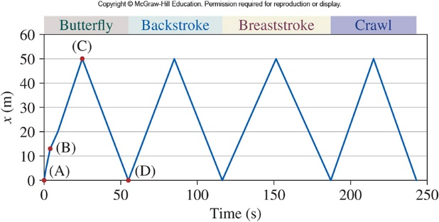
Michael Phelps’s world-record-setting 400-m medley race in the 2008 Summer Olympics.
Phelps’s displacement relative to the edge of the pool is plotted on the vertical axis, versus time on the horizontal.

Slide 28
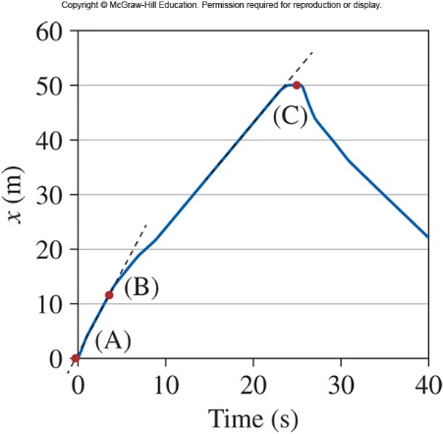
Instantaneous velocity
A blown-up portion of the graph shown in figure 2.1. Two tangent lines are drawn. What do they represent?

Slide 29
Running

Slide 30
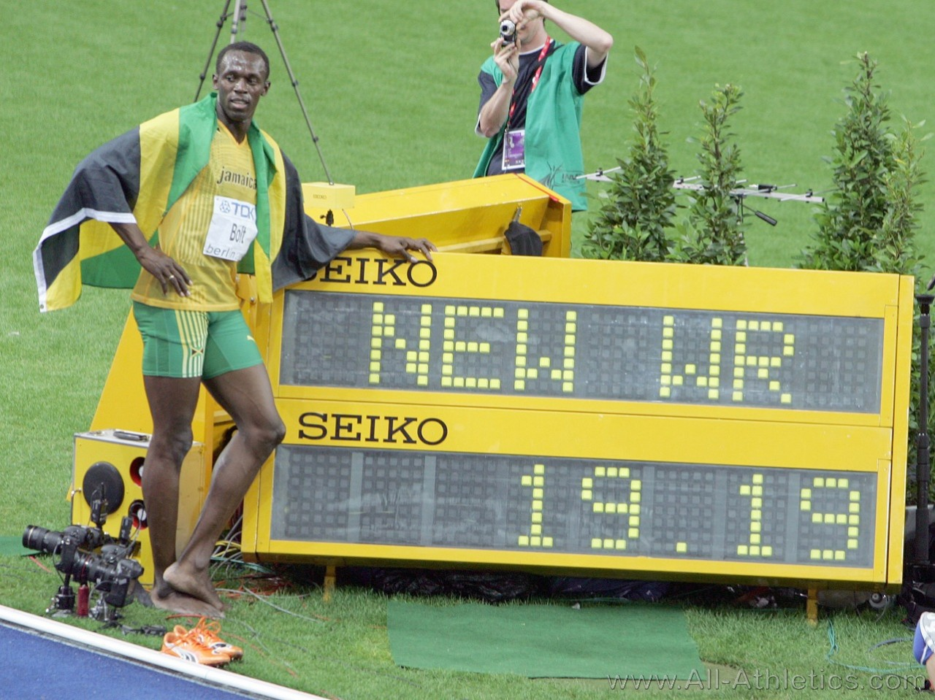
Bolt in Berlin
http://www.all-athletics.com/en-us/photos/usain-bolt-berlin-2009-19

Slide 31
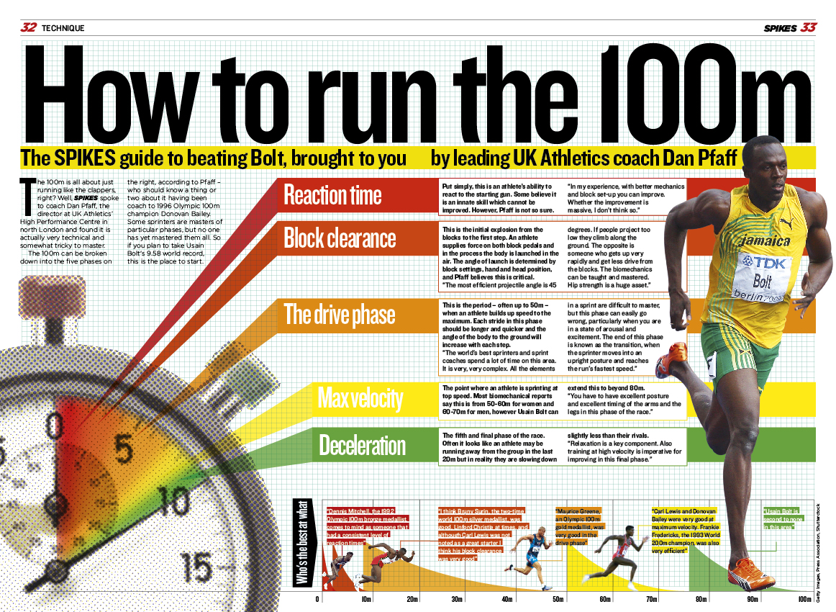
http://speedendurance.com/2017/07/22/will-usain-bolt-win-the-100m-world-championships/

Slide 32
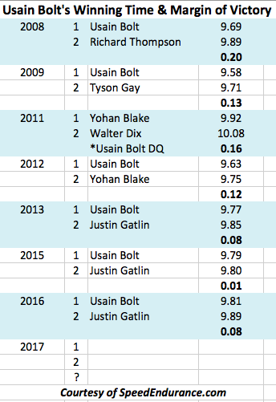

Slide 33
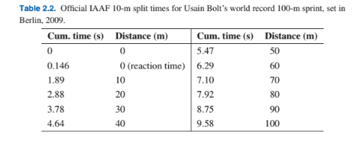

Slide 34
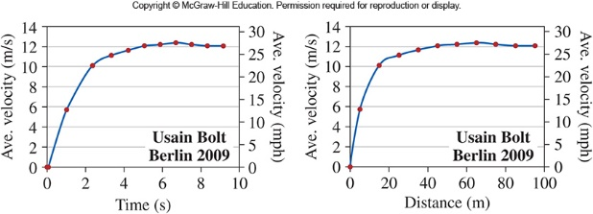
Velocity graphs for Usain Bolt’s record-setting 100-m dash. On the left is the “physicist’s style” of plotting velocity versus time;
the acceleration is the slope of this curve at any point. On the right is a common graph found in sports newspapers and
magazines, of velocity versus distance.

Slide 35
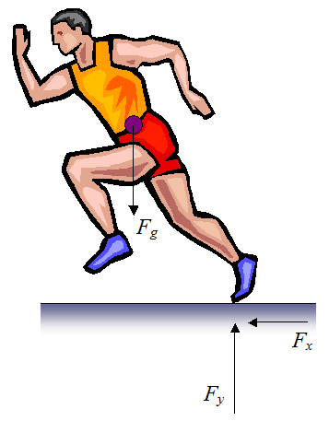
Bolt in Berlin
https://www.real-world-physics-problems.com/physics-of-running.html

Slide 36
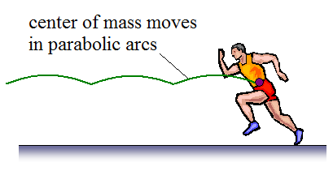
https://www.real-world-physics-problems.com/physics-of-running.html

Slide 37
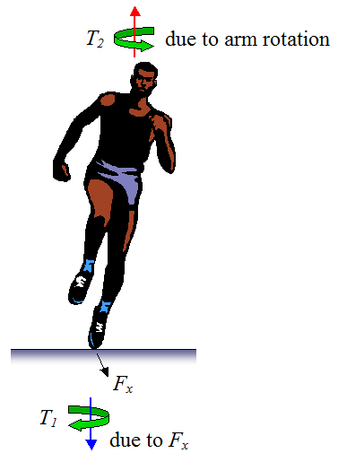
https://www.real-world-physics-problems.com/physics-of-running.html

Slide 38
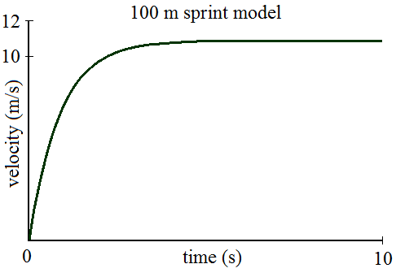
https://www.real-world-physics-problems.com/physics-of-running.html

Slide 39
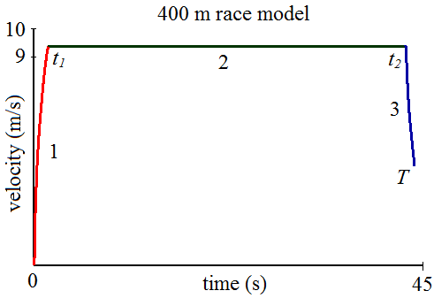
https://www.real-world-physics-problems.com/physics-of-running.html

Slide 40
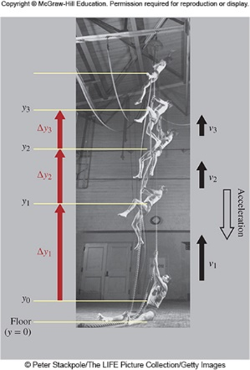
Rope-climbing and diving
Calculate the free fall time from the top, assuming his feet
are 13 ft above the ground at that time.

Slide 41
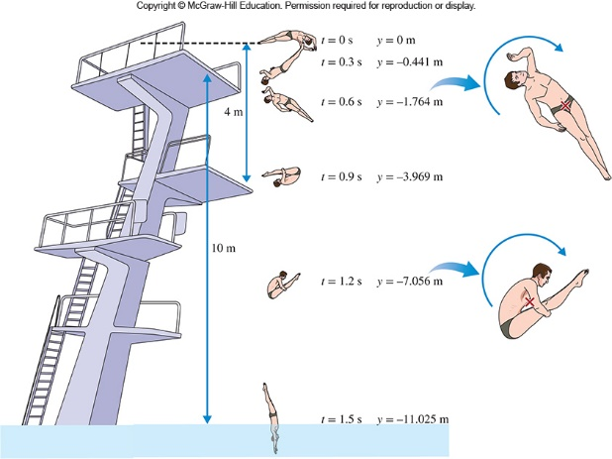

Slide 42
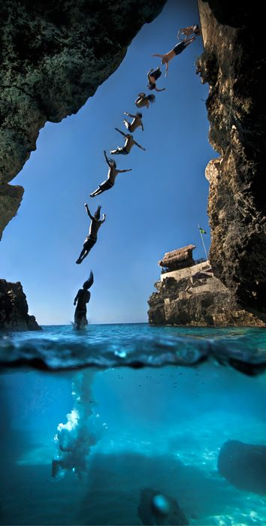
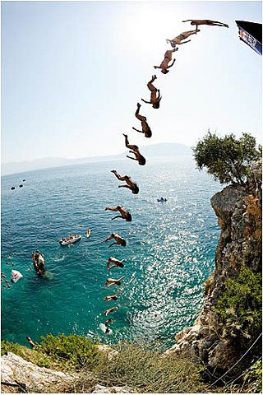
https://www.pinterest.com/beakymcgee/time-lapse-photos/

Slide 43
Food for thought
What is Magnus effect?

Slide 44
References
Dan Whitt, Mathematical Models of Running, UMS talk, September 24, 2008. http://www.stanford.edu/~dwhitt/UMS-talk.pdf
Joseph B. Keller, A Theory of Competitive Running, Physics Today 26(9), 42-47 (1973).
Igor Alexandrov and Philip Lucht, Physics of Sprinting, American Journal of Physics 49, 254-257 (1981).

